Slide 1
Introduction to Data Science Data Mining for Business Analytics
Brian d’Alessandro
VP – Data Science, Dstillery
Adjunct Professor, NYU
Fall 2014
Fine Print: these slides are, and always will be a work in progress. The material presented herein is original, inspired, or borrowed from others’ worl. Where possible, attribution and acknowledgement will be made to content’s original source. Do not distribute, except for as needed as a pedagogical tool in the subject of Data Science.
Notes:
https://www.youtube.com/watch?v=aMDe5pODkB0 (harlan harris)

Slide 2
Programming for ds

Slide 3
Python overview

Slide 4

Intro to python
iPython Notebook
Numpy
Pandas
Scikit-learn
Notes:
Do the demo as well

Slide 5
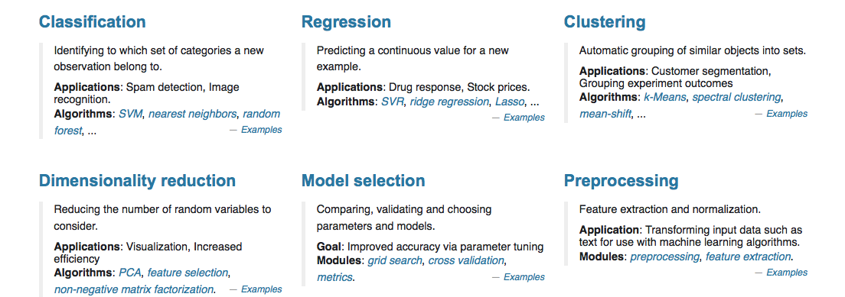
SCIKIt-learn
(for this class at least) we want everything in one box.
Source: http://scikit-learn.org/stable/
Notes:
Do the demo as well

Slide 6
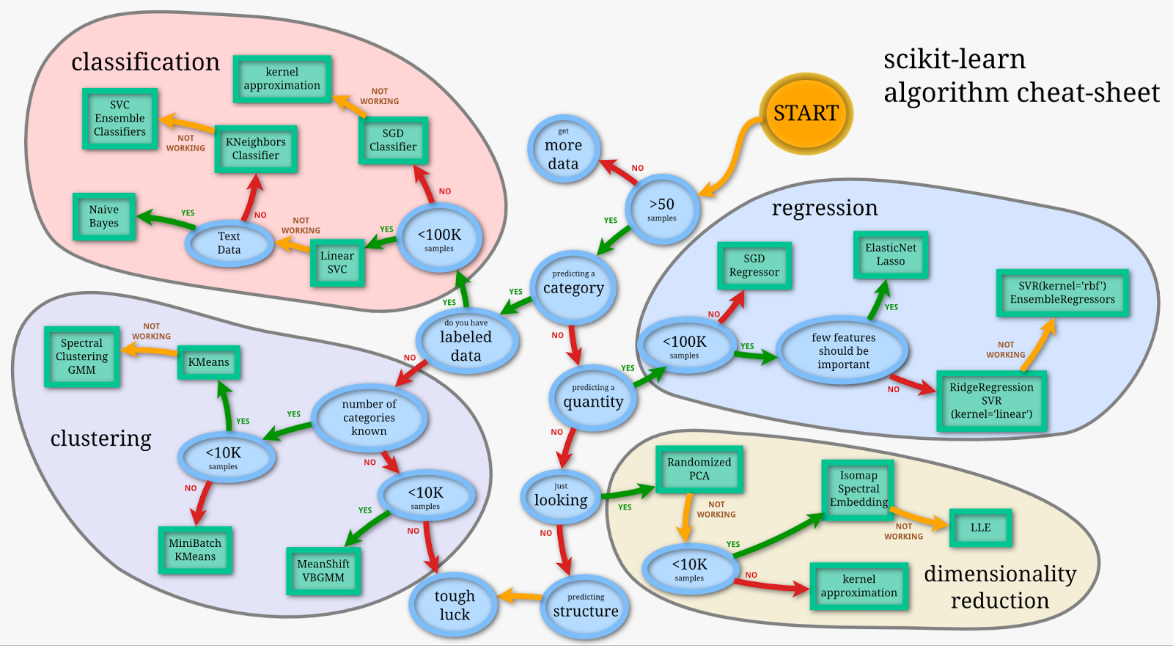
SCIKIt-learn
Source:
http://peekaboo-vision.blogspot.com/2013/01/machine-learning-cheat-sheet-for-scikit.html
Notes:
Do the demo as well

